Slide 1
SWE 4701
Software Metrics and Process
Lec - 4

Slide 2
Measuring Product Size

Slide 3
SW Size
Size is one of the most basic attributes of software.
  How big is the software? How big is it compared to other projects?
  How much effort is it going to take to build the software?
  How does our quality compare to other projects?
  How productive are we compared to other projects?
Size is fundamental to all of these metrics, but difficult to Measure
Various approaches are used to measure SW size
    LINE OF CODE ( LOC)
    TOKEN COUNT ( HALSTEAD PRODUCT METRICS)
    FUNCTION POINT ANALYSIS (FPA)

Slide 4

SW Size Estimation
LINE OF CODE ( LOC)
  This metric is based on the number of lines of code present in the program.
  The lines of code are counted to measure the size of a program.
  The comments and blank lines are ignored during this measurement.
  The LOC metric is often presented on thousands of lines of code ( KLOC).
  Sometime measured as NCLOC (non commented line) or effective line of code.
Total size (LOC) = NCLOC + CLOC (number of comment lines of program text)
The ratio measures of the density of comments in a program.

Slide 5
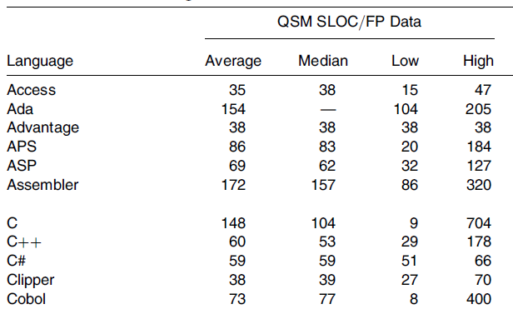
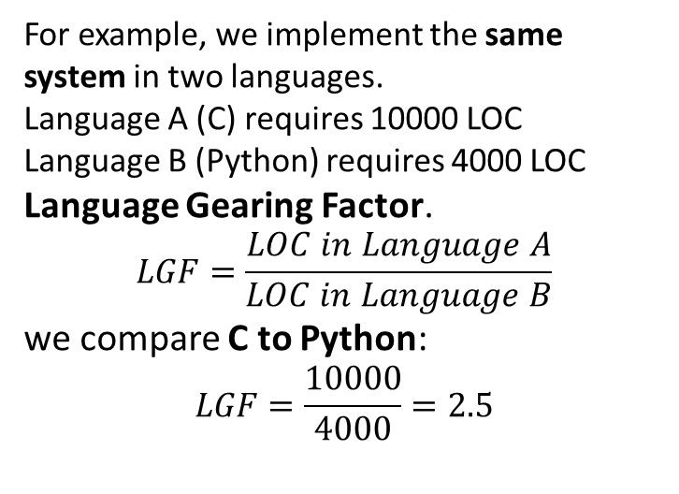
SW Size Estimation
LINE OF CODE ( LOC)
Language gearing factor, which compares the expressiveness of languages and takes into account the differences in productivity in languages.
The more productive a language is, the fewer lines of code you should need to write, and hence, the more productive you should be.
C | 10,000 LOC
For example, we implement the same system in two languages.
Language A (C) requires 10000 LOC
Language B (Python) requires 4000 LOC
Language Gearing Factor.
$$LGF=\frac{LOC in Language A}{LOC in Language B}$$
we compare C to Python:
$$LGF=\frac{10000}{4000}=2.5$$
C requires 2.5 times more code than Python.

Slide 6
SW Size Estimation
TOKEN COUNT ( HALSTEAD PRODUCT METRICS)
  LOC is not consistent, because all lines of code are not at the same level..
  Some lines are more difficult to code than others.
  Halstead stated that any software program could be measured by counting the number of operators and operands.
  From these set of operators and operands, he defined several formulae to calculate the vocabulary, the length, and the volume of the software program.

Slide 7
Guideline for calculating operands and operators:
❖ All the variables and constants are considered as operands.
❖ Local variables with the same name, if occurring in different functions, are counted as unique operands.
❖ Function calls are considered as operators.
❖ The looping statements do … while, while, and for are operators. The statements if, if … else, are operators. The switch … case statements are considered as operators.
❖ The reserve worlds, returns, default, continue, break, and sizeof are all operators.
❖ The brackets, commas, and semicolons are operators.
❖ The unary and binary operators are considered as operators. The & is considered an operator.
❖ In arrays, the array name and index are considered as operands, and [ ] is considered as an operator.
❖ Comments are not considered.

Slide 8
SW Size Estimation
TOKEN COUNT ( HALSTEAD PRODUCT METRICS)
  Halstead Metric
    Program Vocabulary
    It is the number of unique operators plus the number of unique operands as given below:
      n = n1 + n2
      where n = program vocabulary
      n1 = number of unique operators (are symbols/keywords that perform actions)
      n2 = number of unique operands (are variables and constants)

Slide 9
SW Size Estimation
TOKEN COUNT ( HALSTEAD PRODUCT METRICS)
  Halstead Metric
    Program Length
    It is the total usage of all the operators and operands appearing in the implementation.
      N = N1 + N 2
      where N = program length
      N1 = all operators appearing in the implementation
      N2 = all operands appearing in the implementation

Slide 10
SW Size Estimation
TOKEN COUNT ( HALSTEAD PRODUCT METRICS)
  Few Halstead Metric
    Program Volume
    The volume refers to the size of the program and it is defined as the program length times the logarithmic base 2 of the program vocabulary.
      V = N log₂ n
      where V = program volume
      N = program length
      n = program vocabulary
Difficulty: D = (n1/2) * (N2/n2)
Effort: E= D*V

Slide 11
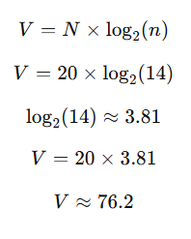
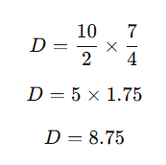
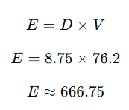
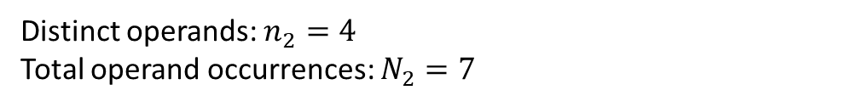
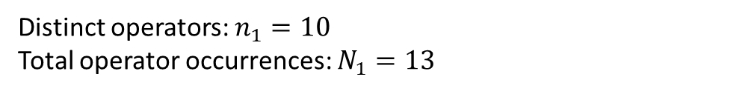
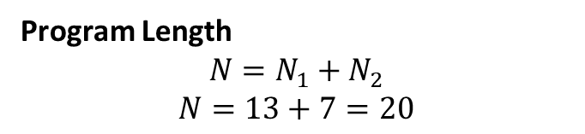
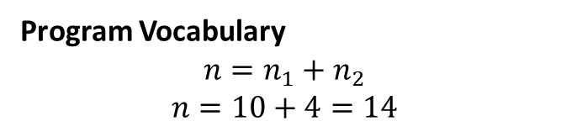
Example
int add(int a, int b) {
int sum = a + b;
return sum;
}
Volume (V)
Operand | Count
add | 1
a | 2
b | 2
sum | 2
Operator | Count
int | 3
( | 1
) | 1
{ | 1
} | 1
, | 1
= | 1
+ | 1
return | 1
; | 2
Distinct operands: $n_{2}=4$
Total operand occurrences: $N_{2}=7$
Difficulty (D)
Program Vocabulary
$$n=n_{1}+n_{2}$$
$$n=10+4=14$$
Program Length
$$N=N_{1}+N_{2}$$
$$N=13+7=20$$
Effort (E)
Distinct operators: $n_{1}=10$
Total operator occurrences: $N_{1}=13$

Slide 12
SW Size Estimation
FUNCTION POINT ANALYSIS (FPA)
    It is based on the idea that the software size should be measured according to the functionalities specified by the user.
    Therefore, FPA is a standardized methodology for measuring various functions of a software from the user’s point of view.
    The size of an application is measured in function points.

Slide 13
SW Size Estimation
FUNCTION POINT ANALYSIS (FPA)
    What do Function Point measure?
X
Functional Requirements
Data Transfer
Storage
Data processing
Retrieval and representation
Requirements
X
Nonfunctional Requirements
Quality
Reliability
Usability
Performance
Security
Project Requirements
Milestones
Budgets
Dependencies
resources

Slide 14
SW Size Estimation
FUNCTION POINT ANALYSIS (FPA)
    Process used to calculate the function points
      1. Determine the type of project for which the function point count is to be calculated. For example, development project (a new project) or enhancement project.
      2. Identify the counting scope and the application boundary.
      3. Identify data functions (internal logical file and external interface files) and their complexity.
      4. Identify transactional functions (external inputs, external outputs, and external queries) and their complexity.
      5. Determine the unadjusted function point count (UFP).
      6. Determine the value adjustment factor (VAF), which is based on 14 general system characteristics (GSCs).
      7. Calculate the adjusted function point count (AFP).

Slide 15
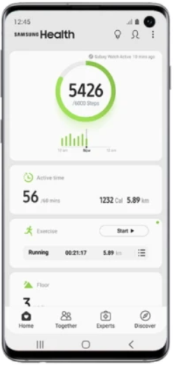



SW Size Estimation
FUNCTION POINT ANALYSIS (FPA)
    The first step in calculating FP is to identify the counting boundary.
    Counting boundary: The border between the application or project being measured and external applications or the user domain.
    A boundary establishes which functions are included in the function point count
Internal data
Internal logical files (ILFs)
Inputs
Outputs
External Inputs(EIs)
External Outputs(EOs)
Queries
External Queries(EQs)
Application boundary
Application boundary
External data
External Interface files (EIFs)
Other System
Other System

Slide 16
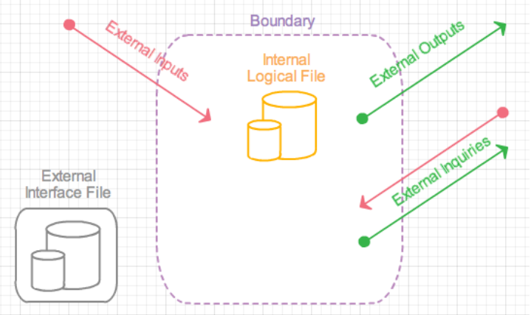
SW Size Estimation
Size Metric: FUNCTION POINT ANALYSIS (FPA)
    Two data files/function types:
      Internal Logical Files (ILF): This is the set of data present within the system. The majority of the data will be interrelated and are captured via the inputs received from the external sources.
      External Interface Files(EIF): represent the data that your application will use/reference, but data that is not maintained by your application.
    Three Transaction types:
      External Inputs (EI): these are end-user actions such as putting in a login or executing a mouse click.
      External Outputs (EO): the system provides the end-user output or interface such as a GUI display or items in a report.
External Inquiries (EQ): this function is initiated by the end-user. For example, the end-user wishes to submit a query to a database or requests on-line help. In any case the developer provides a means for the end-user to "search" for answers.

Slide 17
Example
A company develops an Online Food Ordering Application where customers can browse restaurants, place orders, and track delivery.
Internal Logical File (ILF) : data stored and maintained inside the system.
The system maintains: Customer information, Restaurant menu , Orders…
For example Order Table | OrderID | CustomerID | Restaurant | Total |
Since the system creates, updates, and deletes these records, they are ILF.
External Interface File (EIF): data used by the system but maintained by another system.
The food ordering system uses a Payment Gateway Database (e.g., Stripe, SSLCommerz).
Example: | PaymentID | Status | TransactionID |
Our system reads payment status but does not maintain the payment database. So this is an EIF.
External Input (EI) : actions performed by the user that add or update data.
Customer performs actions such as: Register account, Place order…
This input creates a new order record in the system. So they are External Input (EI).
External Output (EO): generated by the system after processing data.
After placing the order, the system generates Order Confirmation
External Inquiry (EQ): User requests information without modifying data.
When Customer clicks Track Order system displays the status .. No database update, only data retrieval.. So this is EQ.

Slide 18
SW Size Estimation
Size Metric: FUNCTION POINT ANALYSIS (FPA)
    Based on the data function complexity weight is assigned to each data function
Measurement Parameter | Low (simple) | Average | High (complex)
1. external inputs (EI) | 3 | 4 | 6
2. external outputs (EO) | 4 | 5 | 7
3. external inquiries (EQ) | 3 | 4 | 6
4. internal files (ILF) | 5 | 7 | 10
5. external interfaces (EIF) | 7 | 10 | 15
      Count the number of all five components. The sum of each count is multiplied by an appropriate weight using Table above
      Add all the five results calculated in the previous step. This is the final UFP.

Slide 19
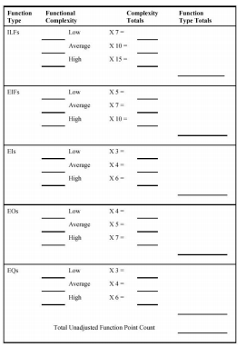
Consider a project with the following parameters: EI = 50, EO = 40, EQ = 35, ILF = 06, and ELF = 04. Assume all weighing factors are average.

Slide 20
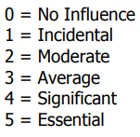
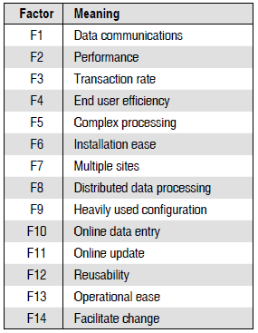
SW Size Estimation
Size Metric: FUNCTION POINT ANALYSIS (FPA)
    Calculating Adjusted Function Point:
      A value adjustment factor ( VAF) is used as a multiplier of the unadjusted function point (UFP) count in order to calculate the adjusted function point ( AFP) count of an application.
To calculate the VAF, we evaluate the 14 GSCs(General system Characteristics) on a scale of 0–5 to determine the degree of influence(DI) for each GSC description.
Add the DIs for all 14 GSCs to produce the total degree of influence (TDI).
Use the TDI in the following equation to compute VAF.
    VAF = (TDI × 0.01) + 0.65
The final adjusted function point is calculated as,
    AFP = UFP × VAF

Slide 21
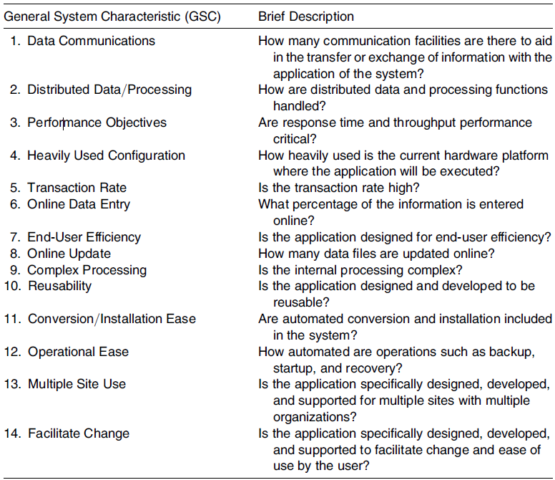
SW Size Estimation

Slide 22
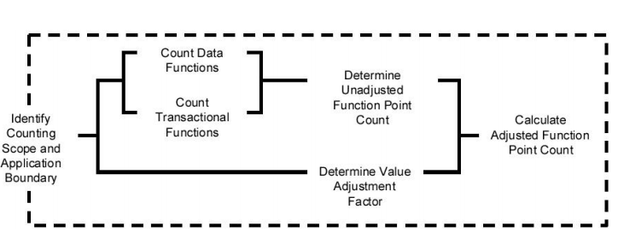
SW Size Estimation
FUNCTION POINT ANALYSIS (FPA)

Slide 23
SW Size Estimation
FUNCTION POINT ANALYSIS (FPA)
    Example:
    Consider a project with the following parameters: EI = 50, EO = 40, EQ = 35, ILF = 06, and ELF = 04. Assume all weighing factors are average. In addition, the system requires Significant performance, average end-user efficiency, moderate distributed data processing, and Significant data communication. Other GSCs are incidental. Compute the function points using FPA.

Slide 24
Measuring Product Complexity

Slide 25
Structural Complexity
System Complexity depends on:
Number of elements (modules, classes, components)
Number of links (relationships, dependencies, interactions)
More interactions → Higher complexity
The following properties define what a valid complexity measure should satisfy:
  Nonnegativity - System complexity cannot be negative. Means No system can have “negative interactions”
  Null Value - If a system has no links between elements, complexity = 0. Example: 5 modules with zero dependencies → Complexity = 0
  Symmetry - Complexity does not depend on how links are represented.
      Suppose we have two modules:
      Module A & Module B and there is a connection between them.
      We can represent it in two ways: A → B or B → A , Even if the direction looks different, there is still one link between A and B. So the complexity caused by this connection should be counted the same way.
  Module Monotonicity - Adding modules cannot decrease total complexity. Means More structure → Same or higher complexity.
  Disjoint Module Additivity - Independent subsystems add up linearly. If A and B are disjoint: C(System) = C(A) + C(B)

Slide 26
Cyclomatic complexity
Cyclomatic complexity is a software metric used to indicate the complexity of a program.
It is a quantitative measure of the number of linearly independent paths through a program's source code.
We need to :
  Draw a control flow graph (to determine different program paths)
  Calculate Cyclomatic complexity using the defined formula

Slide 27
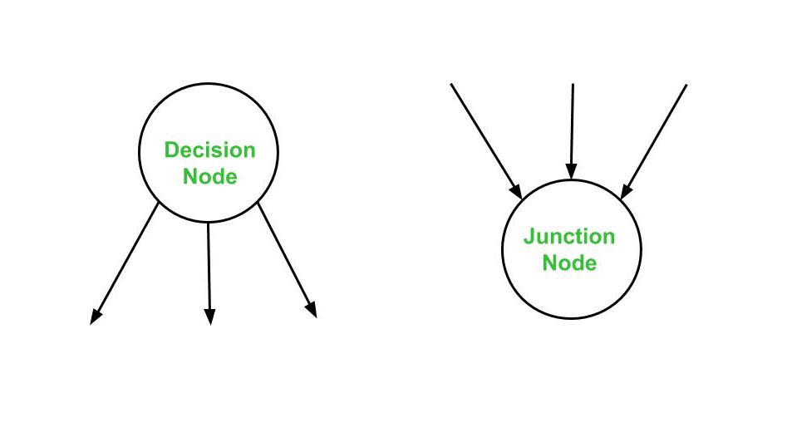
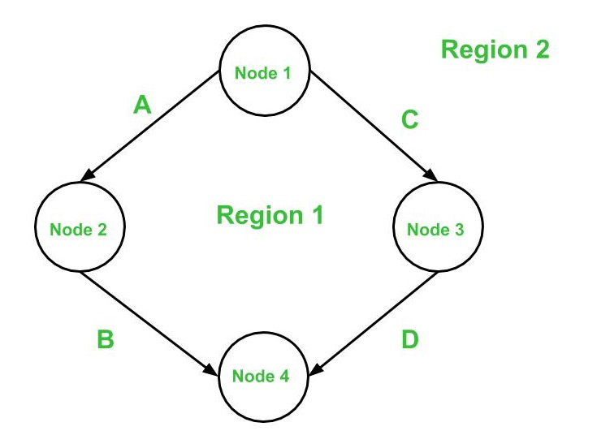
Control Flow Graph
A control flow graph (or simply, flow graph) is a directed graph which represents the control structure of a program or module.
A control flow graph (V, E) has V number of nodes/vertices and E number of edges in it. A control graph can also have :
  Junction Node – a node with more than one arrow entering it.
  Decision Node – a node with more then one arrow leaving it.
  Region – area bounded by edges and nodes (area outside the graph is also counted as a region.).

Slide 28
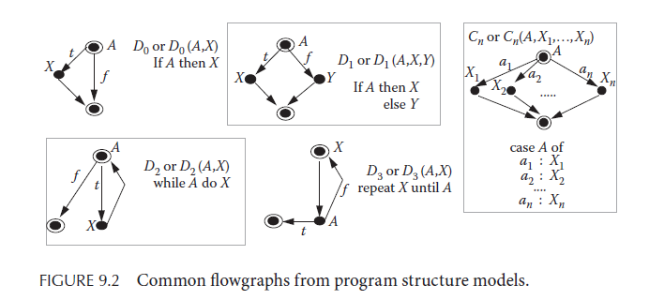
Control Flow Graph

Slide 29
Cyclomatic Complexity
The cyclomatic complexity V(G) is said to be a measure of the logical complexity of a program. It can be calculated using three different formulae :
Formula based on edges and nodes
Formula based on Decision Nodes
Formula based on Regions
V(G) = e - n + 2*P
Where,
e is number of edges,
n is number of vertices,
P is number of connected components.
V(G) = d + P
where,
d is number of decision nodes,
P is number of connected nodes.
V(G) = # of regions (R) in the graph
Calculating the number of decision nodes for Switch-Case/Multiple If-Else
If a decision node has exactly two arrows leaving it, then it is counted as one decision node. However, if there are more than 2 arrows leaving a decision node, it is computed using this formula :
    d = k – 1, where k is the number of arrows leaving the node.

Slide 30
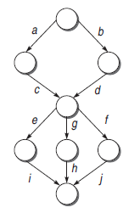
Basis Path Testing : Independent Path
An independent path in the control flow graph is the one which introduces at least one new edge that has not been traversed before the path is defined
cyclomatic complexity gives the number of independent paths present in a flow graph.
In the graph, there are six possible paths: acei, acgh, acfh, bdei, bdgh, bdfj.
In this case, of the six possible paths, only four are independent, as the other two are always a linear combination of the other four paths.
If we calculate the cyclometric complexity, it will be same.

Slide 31
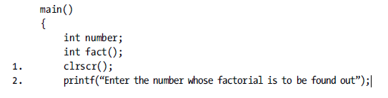
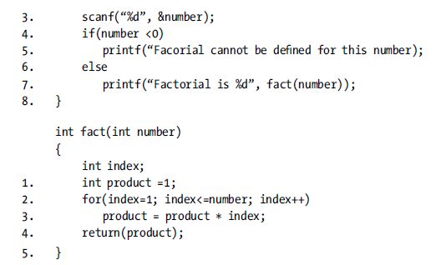
Example
A program for calculating the factorial of a number. It consists of main() program and the module fact().
How to Calculate the Cyclomatic complexity?
If a program P consist of multiple components X, Y, and Z. Then we prepare the flow graph for P and for components, X, Y, and
Z. The complexity number of the whole program is
V (G ) = V (P ) + V (X ) + V (Y ) + V (Z )

Slide 32
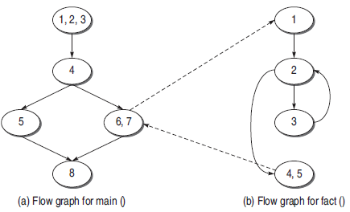
Example

Slide 33
Example
Cyclomatic complexity of main()
(a) V (M) = e − n + 2p
= 5 – 5 + 2
= 2
(b) V (M) = d + p
= 1 + 1
= 2
(c) V (M) = Number of regions = 2
Cyclomatic complexity of fact()
(a) V (R ) = e – n + 2p
= 4 − 4 + 2
= 2
(b) V (R ) = Number of predicate nodes + 1
= 1 + 1
= 2
(c) V (R ) = Number of regions = 2

Slide 34
Example
Cyclomatic complexity of the whole graph considering the full program
(a) V (G ) = e – n + 2p
= 9 − 9 + 2 * 2
= 4
= V (M) + V (R )
(b) V (G ) = d + p
= 2 + 2
= 4
= V (M) + V (R )
(c) V (G ) = Number of regions
= 4
= V (M) + V (R )

Slide 35
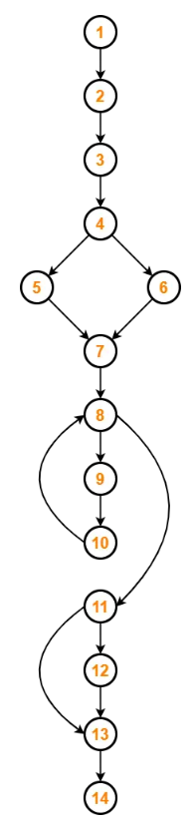
Exercise
Calculate the cyclomatic complexity?

Slide 36
Cyclomatic complexity
Cyclomatic Complexity Classification and Its Impact on Software Quality
Cyclomatic Complexity | Code Quality Level | Testability | Cost & Effort
1 – 10 | Structured and well-written code | High testability | Low cost and effort
11 – 20 | Moderately complex code | Medium testability | Medium cost and effort
21 – 50 | Very complex code | Low testability | High cost and effort
> 50 | Highly complex code | Very difficult / Poor testability | Very high cost and effort
Things to Remember:
It is the maximum number of independent paths through the program code.
It depends only on the number of decisions in the program code.
Insertion or deletion of functional statements from the code does not affect its cyclomatic complexity.
It is always greater than or equal to 1.
Cyclomatic complexity represents the minimum number of tests required to execute every path in the code

Slide 37
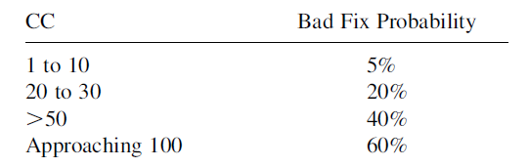
Cyclomatic complexity
As the cyclomatic complexity increases, the difficulty of fixing the code increases.
One interesting extension to cyclomatic complexity is cyclomatic complexity density (CCD). CCD is the CC divided by LOC.
Gill and Kemerer [1] showed that a lower CCD predicts a higher maintenance productivity.
1. G. K. Gill and C. F. Kemerer, “Cyclomatic complexity density and software maintenance productivity,” IEEE Transactions on Software Engineering 17(12): 1284–1288 (1991).

Slide 38
Object-Oriented Structural Attributes and Measures
Object-oriented (OO) designs are built using classes, which define sets of objects.
Key Components:
  Methods: Correspond to functions in procedural languages.
  Interfaces/Abstract Classes: Define structures without full implementation.
  Namespaces/Packages: Group related classes together.

Slide 39
Measuring Coupling in OO Systems
Coupling: The degree of interdependence between software modules.
Persistent Coupling: Connections that remain active over the lifetime of an object.
  Examples: Objects coupled through state variables; Generalization/specialization via inheritance.
Transient Coupling : Connections that only last temporarily.
  Examples: A method call connecting a client to a server object (lasts only while the method is active)

Slide 40
Class Coupling Measures (CBO & RFC)
Coupling Between Object Classes (CBO):
  Definition: The number of other classes to which a class is coupled.
  Does not satisfy the "disjoint module additivity" property. If two classes merge, their combined CBO might not equal the sum of their individual CBOs.
Response for Class (RFC):
  Definition: The size of the "response set" (number of local methods + external methods called by local methods).
  Like CBO, it counts the number of methods invoked rather than the number of connections/uses, violating additivity properties.
Message Passing Coupling (MPC):
  Definition: A count of the number of static invocations (call statements) of methods that are external to the class.
  Unlike CBO and RFC, MPC satisfies all standard coupling properties, including disjoint module additivity.
CBO → How many classes I touch?
RFC → How many methods may run?
MPC → How many actual message calls exist?

Slide 41
Example
class Payment {
void process() {
Bank.validate();
Logger.log();
}
}
class Bank {
static void validate() { }
}
class Logger {
static void log() { }
}
Let’s compute the metrics for class Payment
CBO : Number of other classes to which a class is coupled.
In Payment we uses Bank & Logger
So: CBO(Payment) = 2
RFC : Number of methods that can execute in response to a message to the class.
In Payment: Local method: process() → 1
External calls: Bank.validate() & Logger.log()
So: RFC(Payment) = 3
MPC : Number of external method calls (call statements)..
In Payment: Bank.validate() & Logger.log()
So: MPC(Payment) = 2

Slide 42
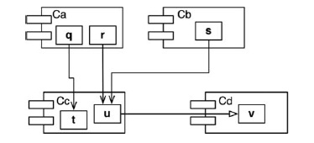
Package or Component Coupling
Fan-in: Incoming dependencies. This metric identifies the number of classes outside this component that depend on classes within the component.
Fan-out: Outgoing dependencies. This metric identifies the number of classes inside this component that depend on classes outside the component.
Instability (I) Metric: I = Fan-out / (Fan-in + Fan-out).
This metric has the range [0, 1]. 0 indicates a maximally stable component. 1 indicates a maximally unstable component.
Let’s say we want to calculate the stability of the component Cc. We find that there are three classes outside Cc that depend on classes in Cc. Thus, Fan-in = 3. Moreover, there is one class outside Cc that classes in Cc depend on. Thus, Fan-out = 1 and I = 1/4.
Not All Components Should Be Stable

Slide 43
Cohesion Measures (TCC, LCC, RCI)
Tight Class Cohesion (TCC) & Loose Class Cohesion (LCC):
  TCC: Relative number of direct connections between methods (sharing instance variables).
  LCC: Relative number of direct AND indirect connections.
Ratio of Cohesive Interactions (RCI):
  Definition: Ratio of actual cohesive interactions (data declarations, parameters, return types) to the maximum possible interactions.

Slide 44

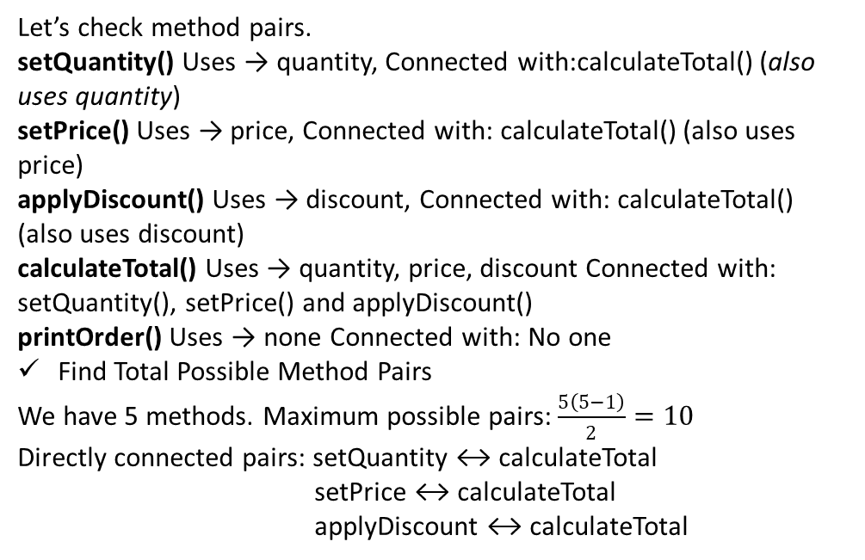
Example
Calculate TCC:
Step 1: Understand Direct Connection
  Two methods are directly connected if they use at least one common instance variable.
Step 2: Find Direct Connections
class Order {
private int quantity;
private double price;
private double discount;
public void setQuantity(int q) {
quantity = q;
}
public void setPrice(double p) {
price = p;
}
public double calculateTotal() {
return quantity * price - discount;
}
public void applyDiscount(double d) {
discount = d;
}
public void printOrder() {
System.out.println("Order printed");
}
}
Let’s check method pairs.
setQuantity() Uses → quantity, Connected with:calculateTotal() (also uses quantity)
setPrice() Uses → price, Connected with: calculateTotal() (also uses price)
applyDiscount() Uses → discount, Connected with: calculateTotal() (also uses discount)
calculateTotal() Uses → quantity, price, discount Connected with: setQuantity(), setPrice() and applyDiscount()
printOrder() Uses → none Connected with: No one
Find Total Possible Method Pairs
We have 5 methods. Maximum possible pairs: $\frac{5\left(5−1\right)}{2}=10$
Directly connected pairs: setQuantity ↔ calculateTotal
setPrice ↔ calculateTotal
applyDiscount ↔ calculateTotal

Slide 45
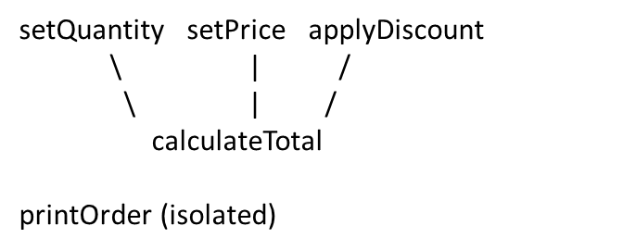
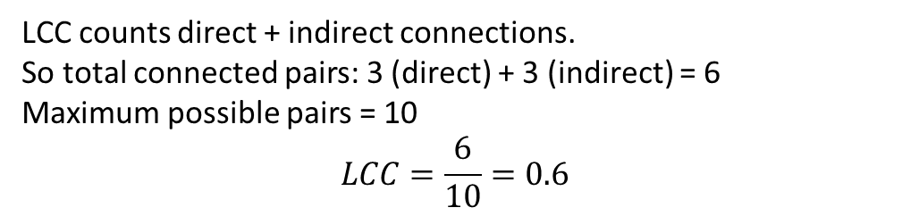
Example
Calculate LCC:
Step 1: Direct connections
  We already calculated that as 3
Step 2: Find Indirect connections
  Two methods are indirectly connected if there is a path through other connected methods.
class Order {
private int quantity;
private double price;
private double discount;
public void setQuantity(int q) {
quantity = q;
}
public void setPrice(double p) {
price = p;
}
public double calculateTotal() {
return quantity * price - discount;
}
public void applyDiscount(double d) {
discount = d;
}
public void printOrder() {
System.out.println("Order printed");
}
}
So indirect pairs:
setQuantity setPrice (through calculateTotal)
setQuantity applyDiscount (through calculateTotal)
setPrice applyDiscount (through calculateTotal)
LCC counts direct + indirect connections.
So total connected pairs: 3 (direct) + 3 (indirect) = 6
Maximum possible pairs = 10
$$LCC=\frac{6}{10}=0.6$$

Slide 46

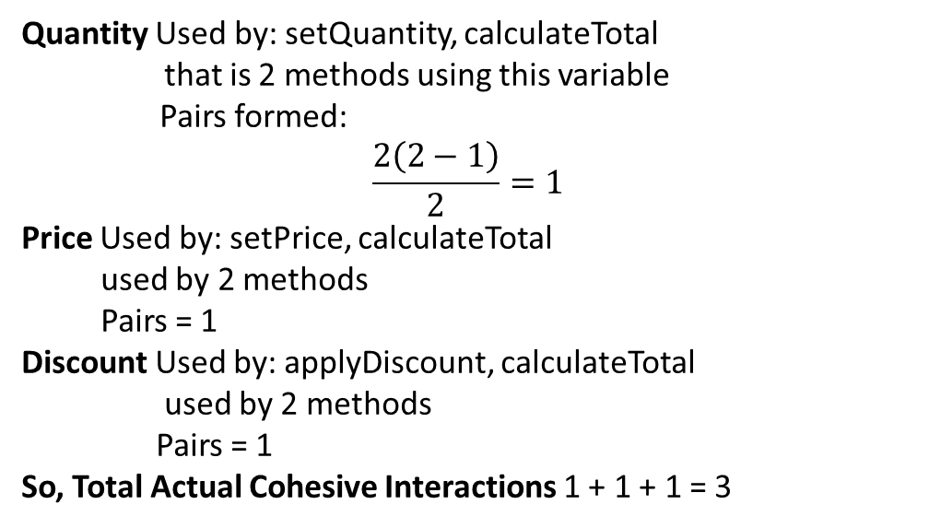
Example
Calculate RCI:
Step 1: count actual variable sharing interactions.
  List how many methods use each variable
class Order {
private int quantity;
private double price;
private double discount;
public void setQuantity(int q) {
quantity = q;
}
public void setPrice(double p) {
price = p;
}
public double calculateTotal() {
return quantity * price - discount;
}
public void applyDiscount(double d) {
discount = d;
}
public void printOrder() {
System.out.println("Order printed");
}
}
Quantity Used by: setQuantity, calculateTotal
that is 2 methods using this variable
Pairs formed:
$$\frac{2\left(2−1\right)}{2}=1$$
Price Used by: setPrice, calculateTotal
used by 2 methods
Pairs = 1
Discount Used by: applyDiscount, calculateTotal
used by 2 methods
Pairs = 1
So, Total Actual Cohesive Interactions 1 + 1 + 1 = 3
Total method pairs = 10
$$RCI=\frac{3}{10}=0.3$$

Slide 47
Object-Oriented Length Measures
In object-oriented models, length usually means the distance from one element to another
In inheritance, Distance means the number of inheritance links
Depth of Inheritance Tree (DIT)
DIT is the length of the longest path from a class to the root of the inheritance tree.
Means How many parent levels does this class have?
Now calculate DIT:
  DIT(Animal) = 0 (no parent)
  DIT(Dog) = 1
  DIT(GermanShepherd) = 2
class Animal { } // Root
class Dog extends Animal { }
class GermanShepherd extends Dog { }

Slide 48
Depth of Inheritance Tree (DIT)
Why DIT Matters
When a class has high DIT:
  It inherits many methods
  Behavior is affected by many ancestors
  Harder to understand
  Harder to test
  Changes in parent affect many children
Higher DIT = Higher complexity (usually)
DIT Interpretation
DIT Value | Meaning
0 | No inheritance
1 | Direct child of root
2–3 | Moderate inheritance
4–6 | Deep hierarchy
> 6 | Very deep, potentially complex

Slide 49
Measuring Object-Oriented Reuse
In Object-Oriented (OO) systems, one major benefit is code reuse.
Features like inheritance, encapsulation, interfaces, and libraries allow developers to reuse existing components instead of writing everything from scratch.
To measure this reuse, we analyze it from two perspectives:
  Client Perspective
  Server Perspective

Slide 50
Measuring Object-Oriented Reuse
Client Perspective (Reuse by the New System)
  We measure how much existing code the new system is using.
  The client is the new system or module that is reusing components.
What we generally count:
  Direct server classes (classes directly reused)
  Indirect server classes (classes reused through inheritance or dependency chains)
Example:
Suppose we are building an E-commerce System.
Our system uses following existing classes from a library:
Reuse from client perspective
Direct servers used by the new system:
  PaymentGateway
  Logger
  EmailService
Indirect servers:
  SecurityManager
  EncryptionService
So the new system is reusing 5 classes in total.
This shows high reuse from the client perspective.
PaymentGateway
Logger
EmailService
And PaymentGateway internally uses:
SecurityManager
EncryptionService

Slide 51
Measuring Object-Oriented Reuse
Server Perspective (Reuse of Existing Components)
We measure how often an existing component is reused by other systems.
The server is the existing reusable component.
We check how many clients depend on it.
Example:
Suppose we have a reusable library class:
class Logger
This class is used in multiple systems:
Banking System
E-commerce System
Hospital Management System
Airline Reservation System
Number of clients using Logger = 4
From the server perspective, the Logger class has high reuse.

